Slide 1
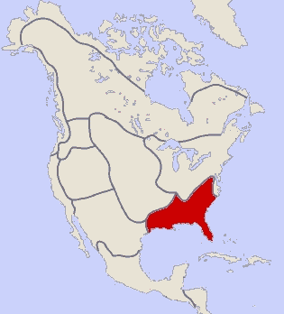
Native Americans-
Part 5
Native Americans of the Southeast
Introduction

Slide 2
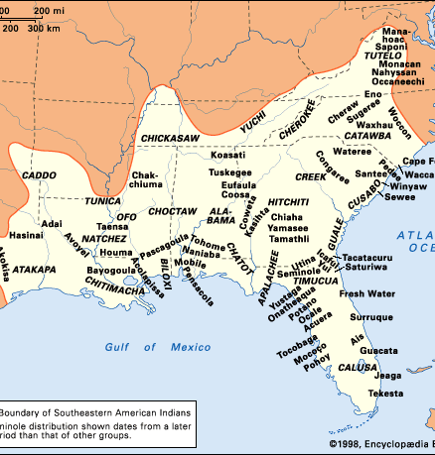
There were around two dozen Native American tribes living in the southeastern part of the U.S. by the time Europeans came to America.

Slide 3
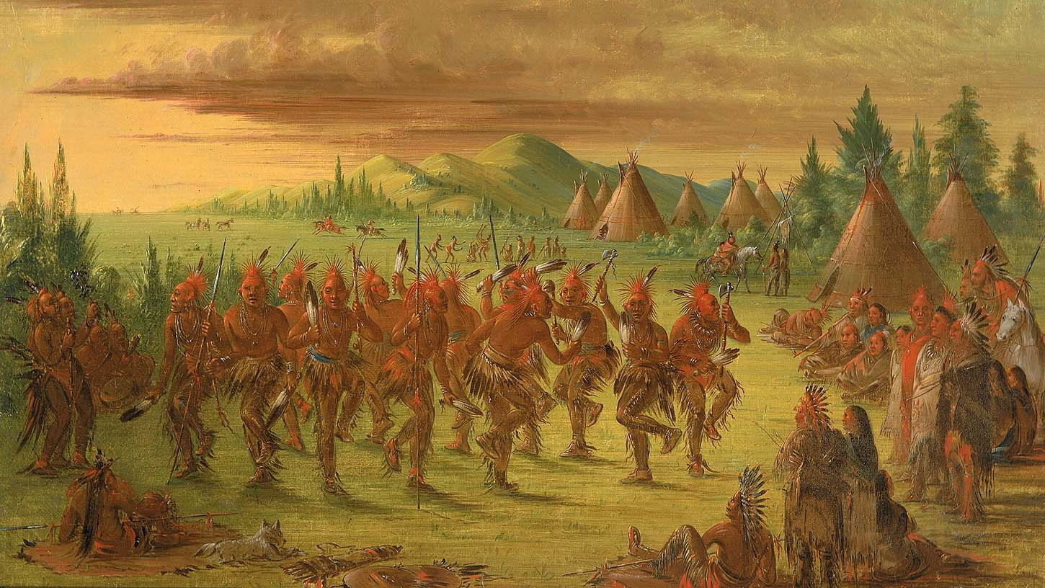
They included tribes such as the Choctaw, Chickasaw, Creek, Cherokee, and Seminole.

Slide 4
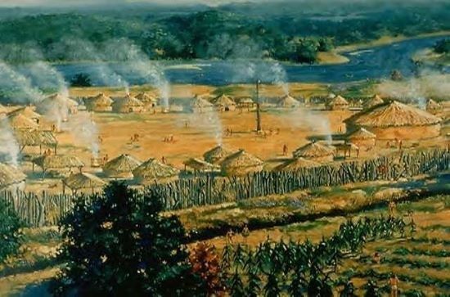
Many Natives lived in villages of less than 500 people, smaller than some of the city-states of the Mississippian culture years before.

Slide 5
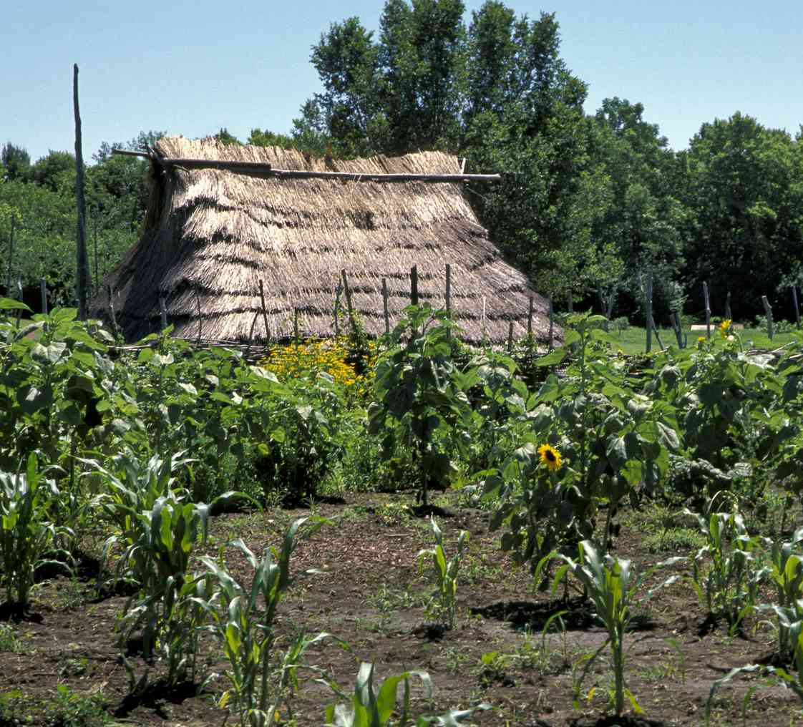
Many of these Native Americans were farmers. The women usually tended the crops during the summer and the men helped with the harvest in the fall.

Slide 6
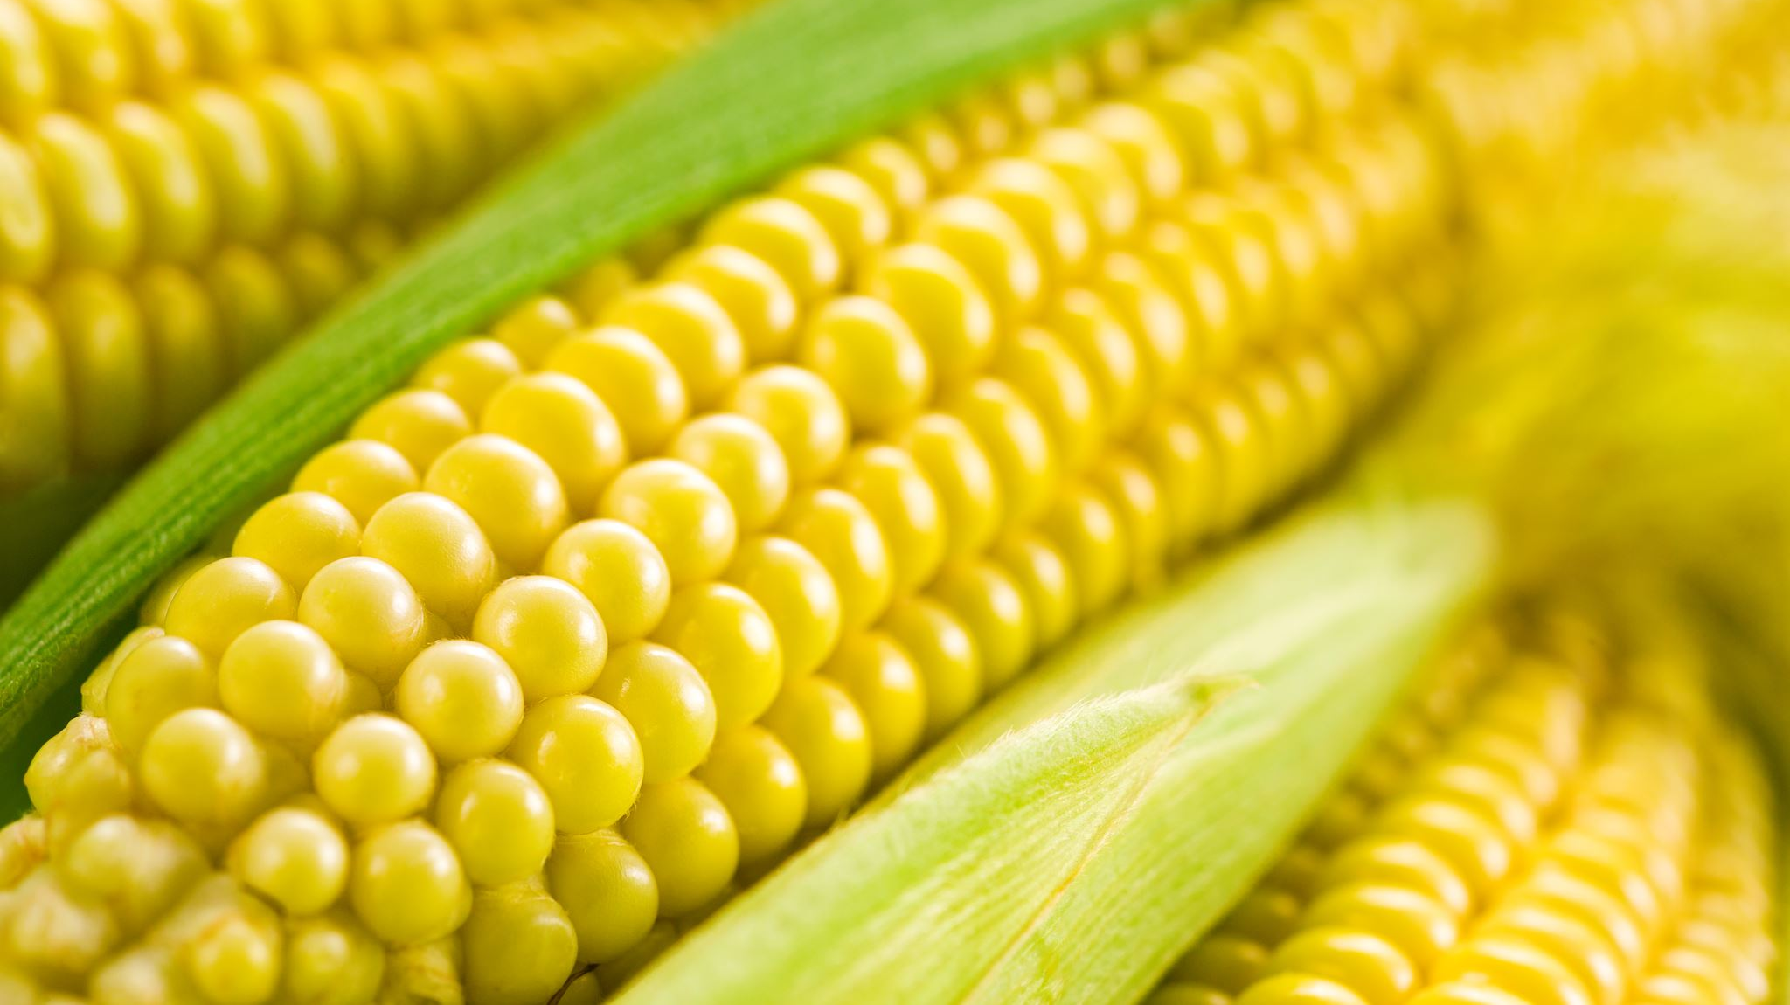
They grew crops like corn, beans, squash, sunflowers, and tobacco.

Slide 7
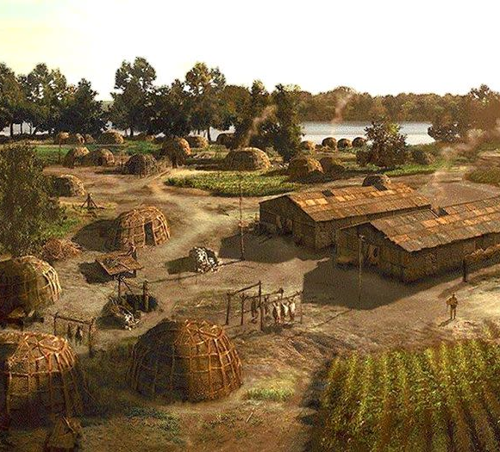
The length of the growing season in the Southeast allowed many fields to be planted twice each year.

Slide 8
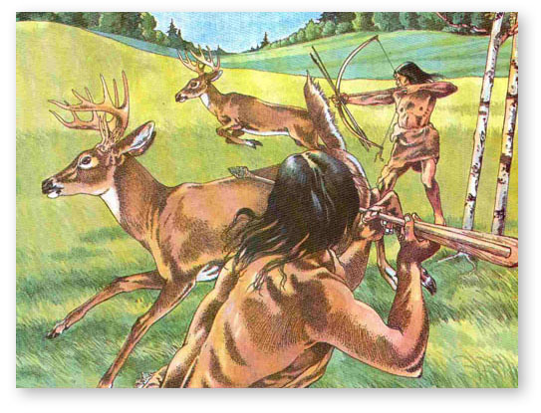
The men also hunted and fished, sometimes spending months hunting in the woodland. Deer was the most hunted animal.

Slide 9
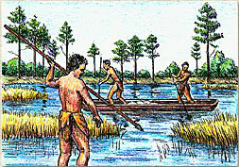
Coastal groups gathered oysters, clams, mussels, and crabs, while those living inland collected freshwater mussels and crayfish.

Slide 10
In much of the region, people built circular, conical-roofed houses that were sealed tight except for an entryway and smoke hole. They had a gabled, thatch-roofed and were made from a framework of upright poles and walled with wattle and daub.

Slide 11
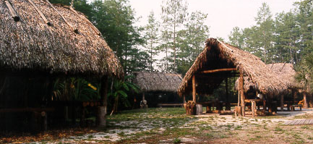
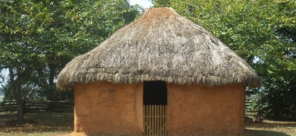
Wattle and Daub Video

Slide 12
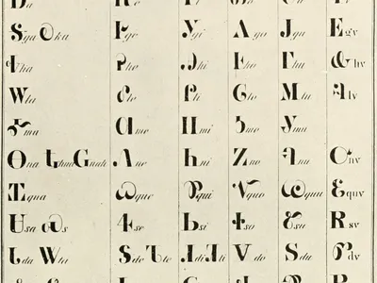
Several different languages were spoken throughout the tribes of this region. These include the Muskogean, Siouan, Iroquoian, and Caddoan language families.

Slide 13
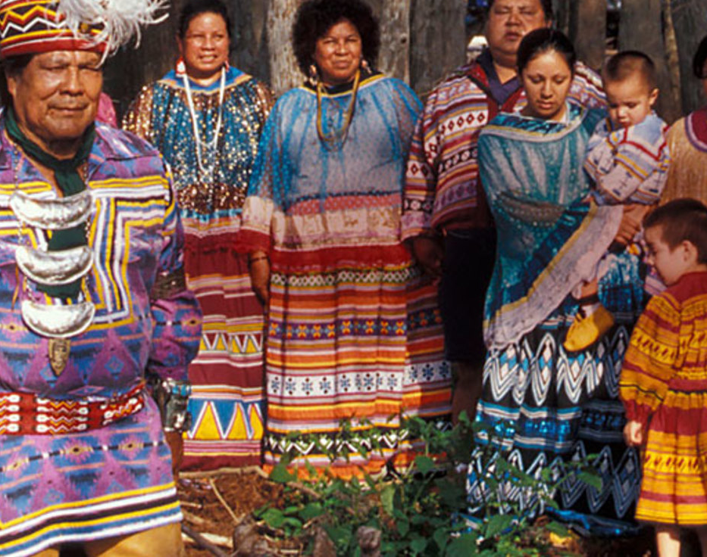
Among Southeastern peoples, descent was usually through the women. Often after a marriage, the couple would live with the wife’s family until they started a family of their own.

Slide 14
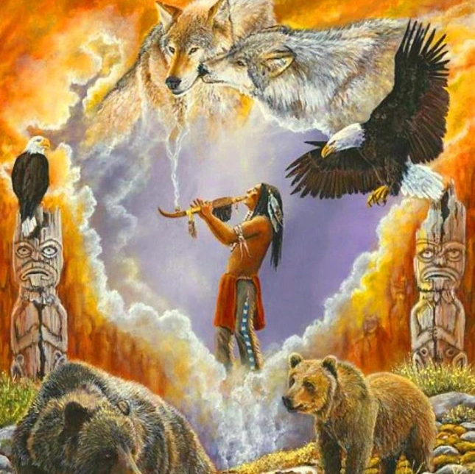
Religion in this region emphasized animism, a belief that natural objects such as rivers and rocks possess a soul or spirit.

Slide 15
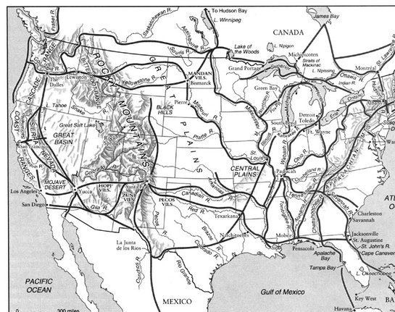
Tribes of the southeast traded with each other as well as with tribes from other regions, including as far away as South America.

